Slide 1


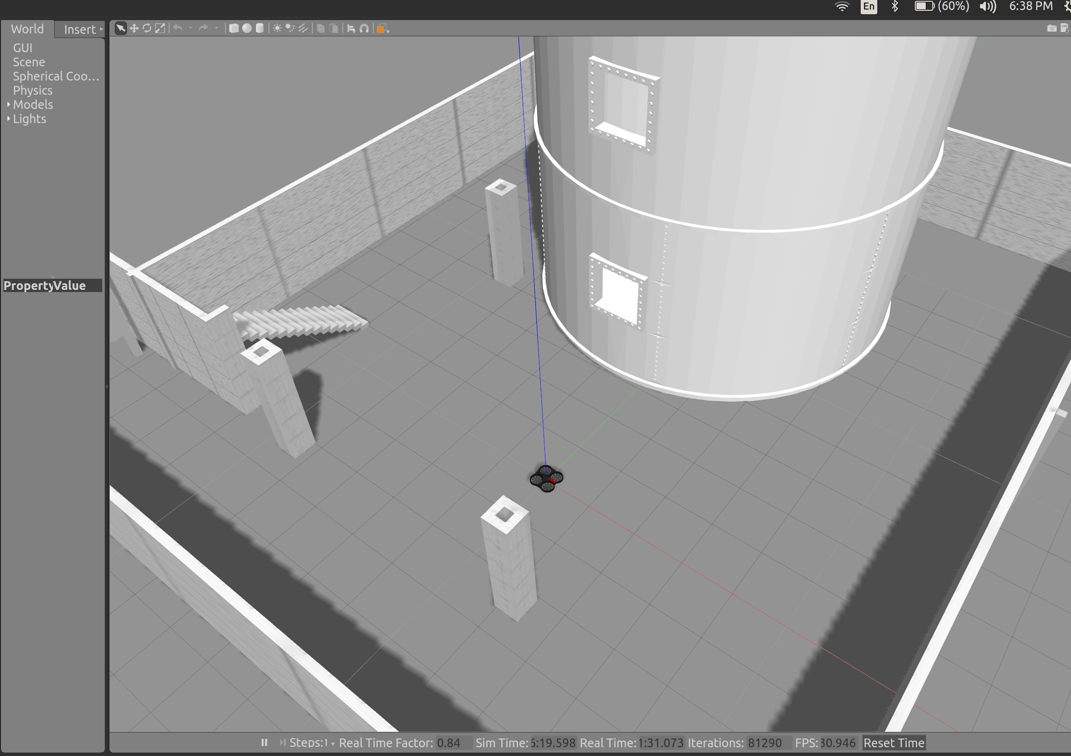


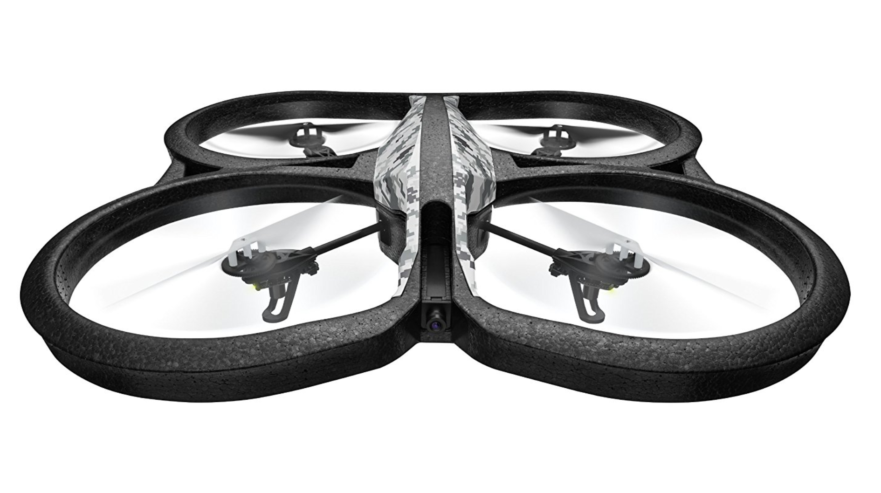
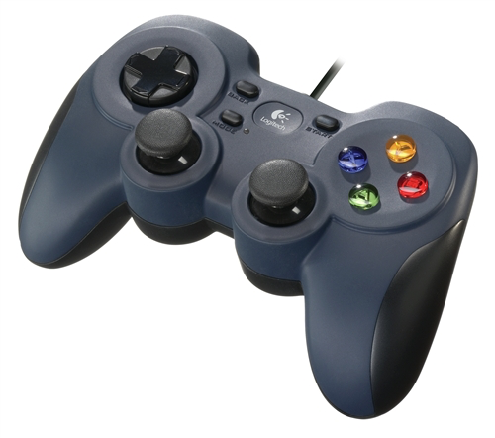
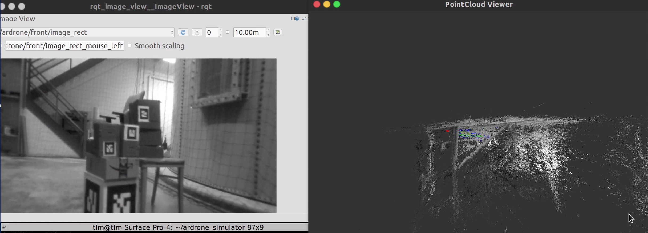
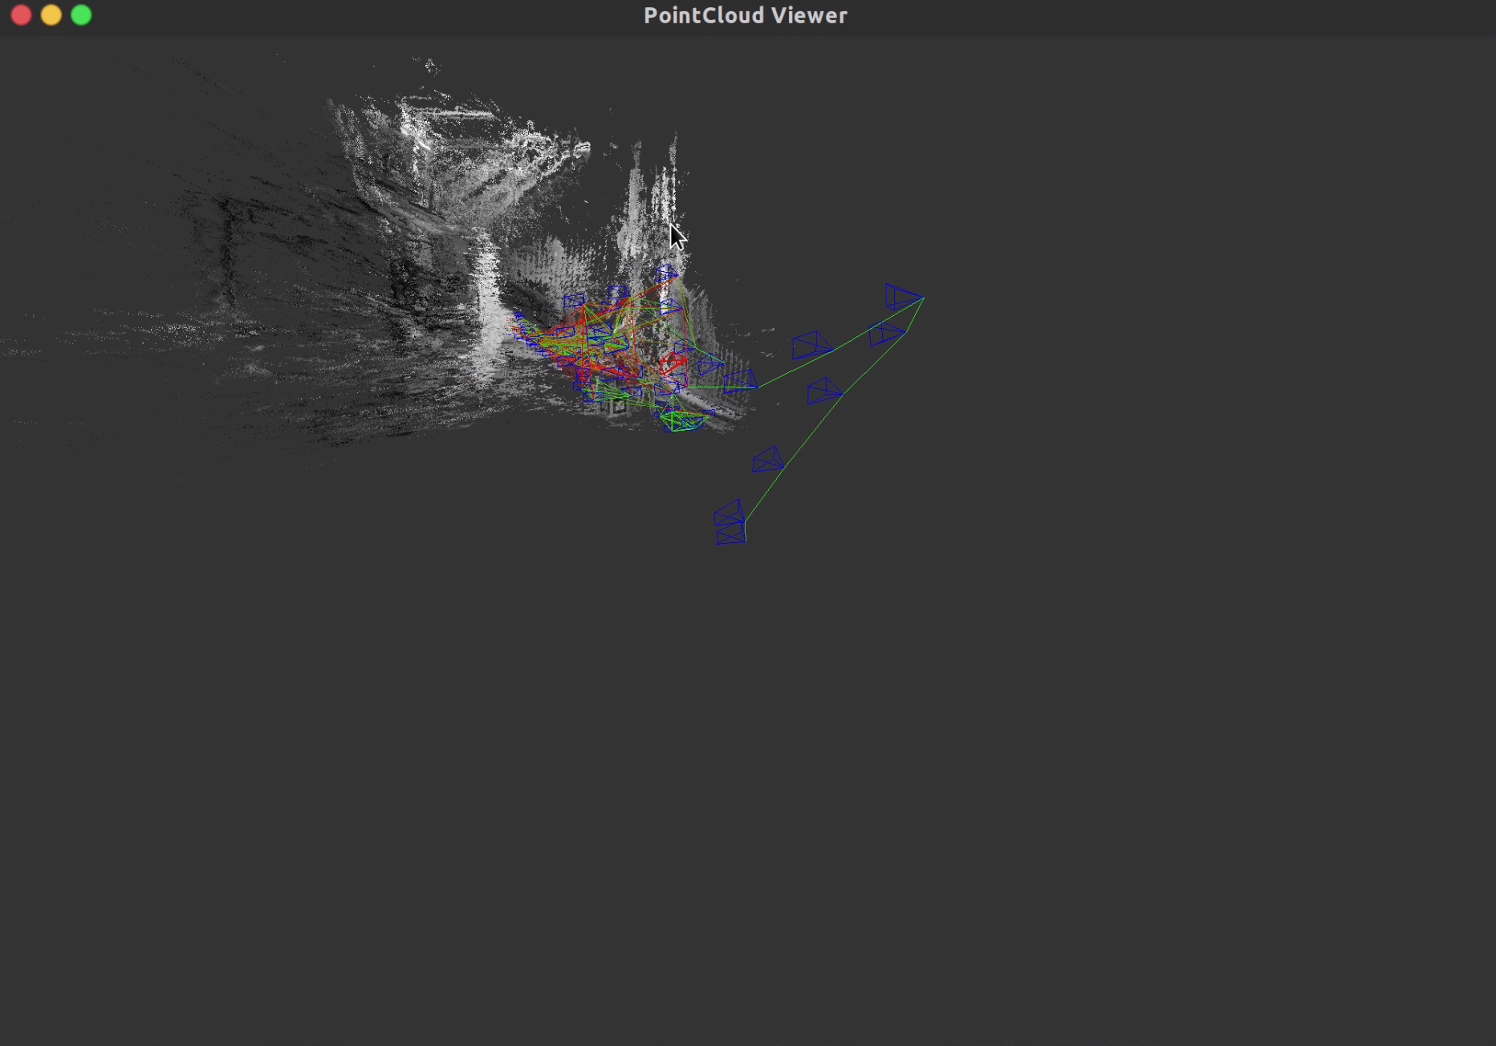
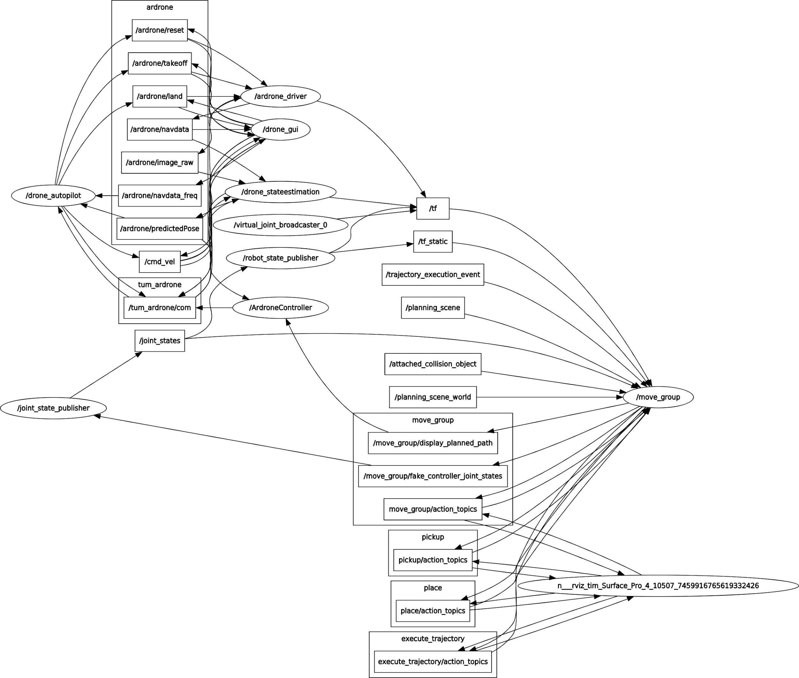
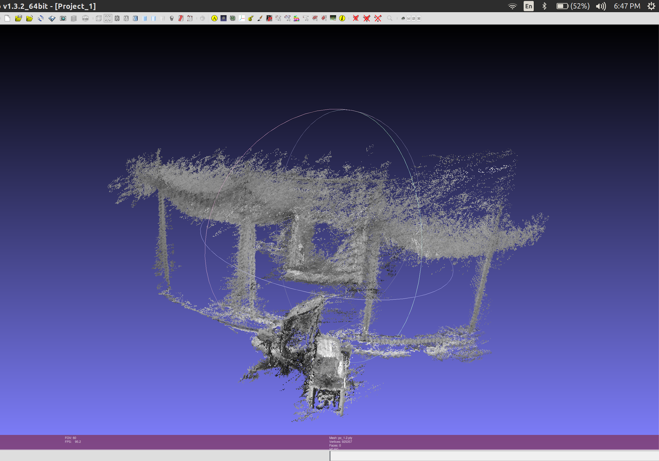
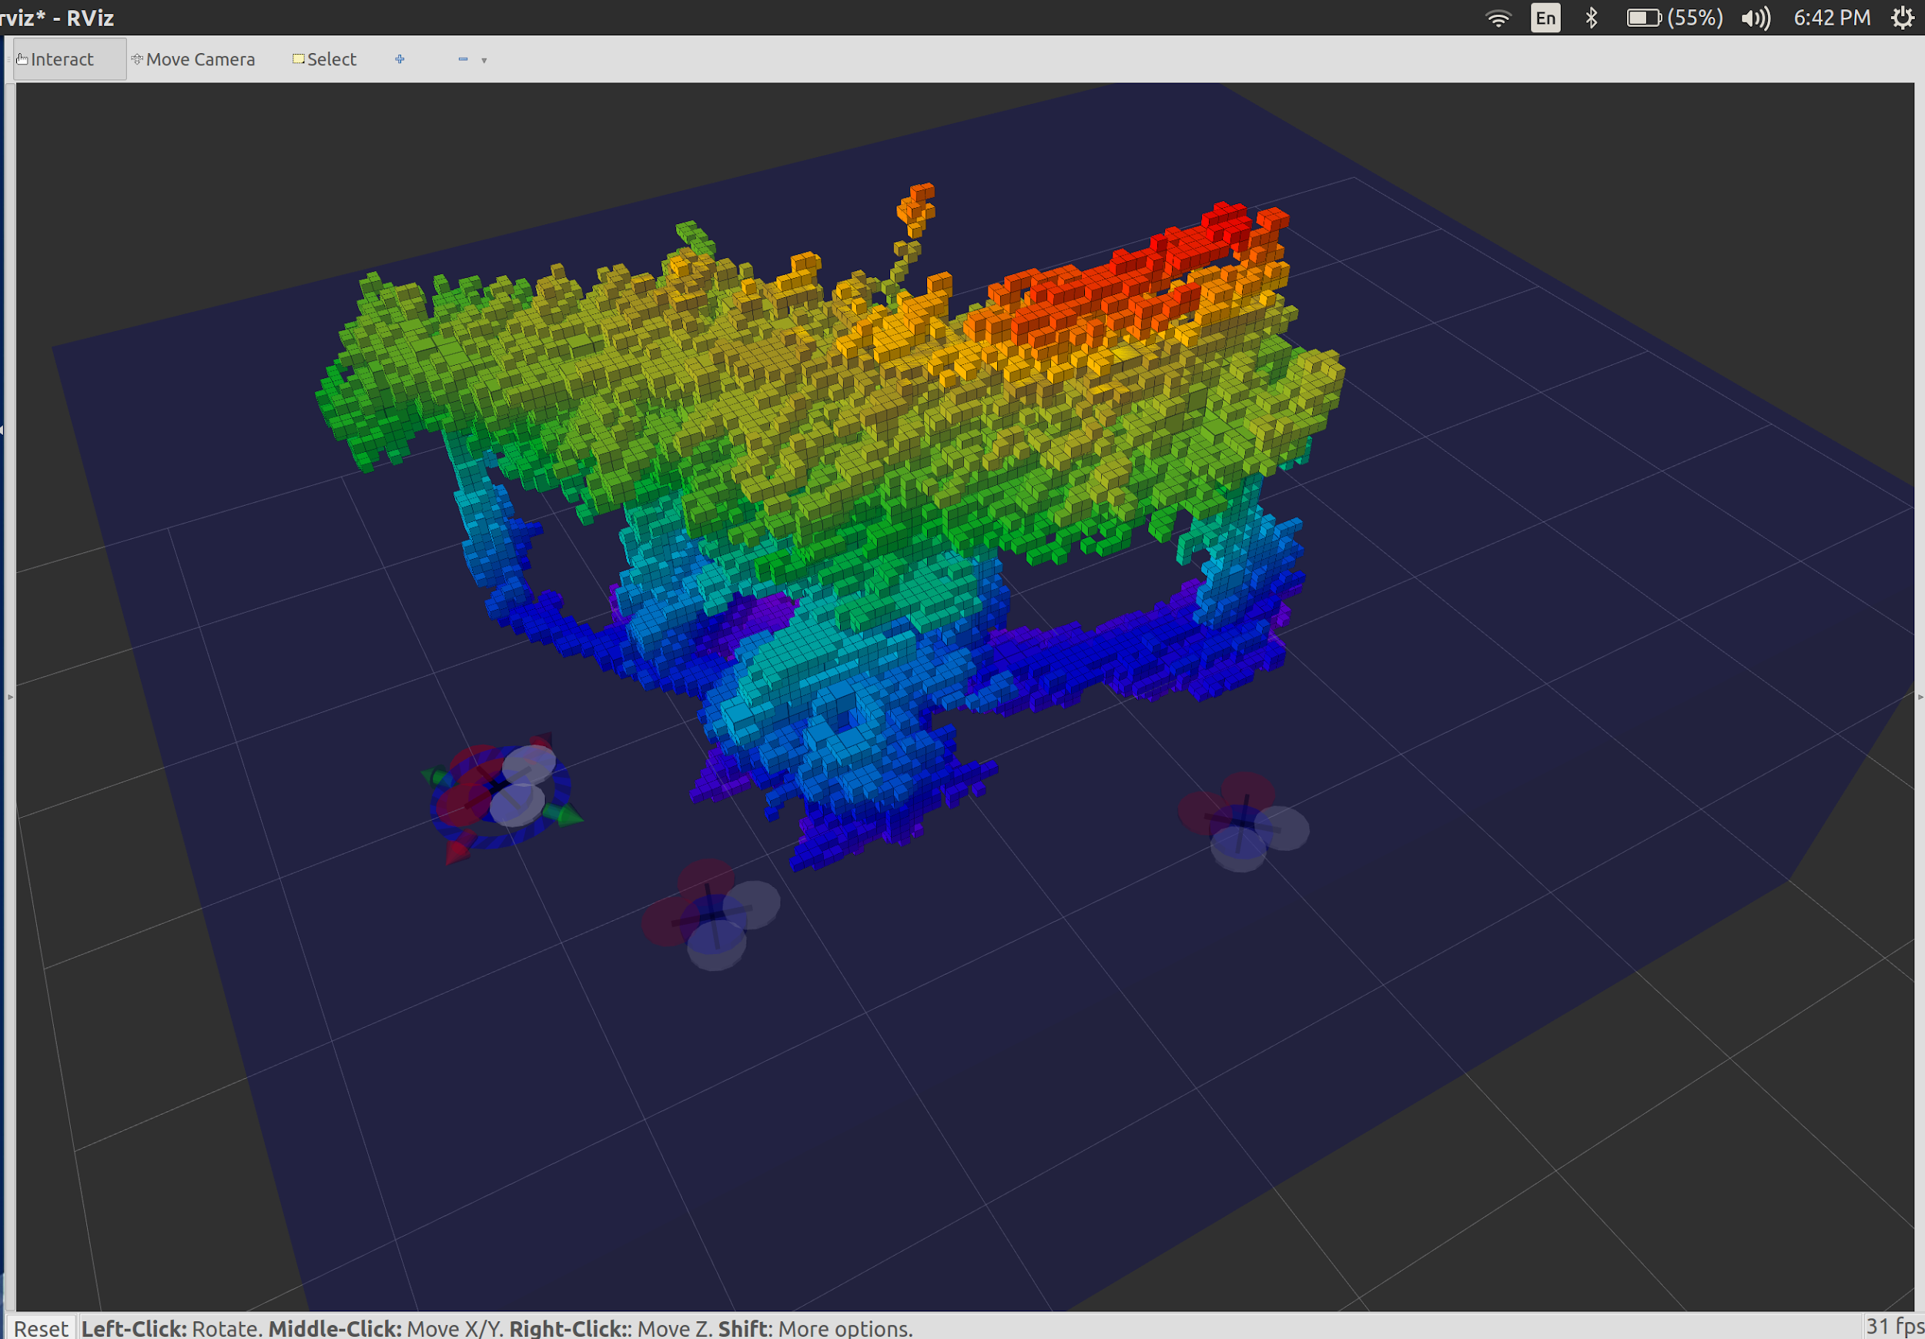
3D Visual SLAM and Path Planning
using AR Drone
Tianyu Song, Huixiang Li, Wenhao Gu
530.707 Robot Systems Programming Independent Class Project
Johns Hopkins University | Whiting School of Engineering | Baltimore, MD
Introduction
Software
This project focuses on a fusion of monocular vision and IMU to robustly track the position of an AR drone using LSD-SLAM (Large-Scale Direct Monocular SLAM) algorithm. The system consists of a low-cost commercial drone and a remote control unit to computationally afford the SLAM algorithms using a distributed node system based on ROS (Robot Operating System). Upon finishing this project, it is expected that we are able to reconstruct the 3D environment around AR drone and localize the drone.
Simultaneous Localization and Mapping (SLAM) for Unmanned Aerial Vehicles (UAVs) in the context of rescue and/or recognition navigation tasks in indoor environments has been a hot topic for several years.
LSD-SLAM is a novel, direct monocular SLAM technique developed by TUM: Instead of using keypoints, it directly operates on image intensities both for tracking and mapping. The camera is tracked using direct image alignment, while geometry is estimated in the form of semi-dense depth maps, obtained by filtering over many pixel-wise stereo comparisons.
Existing available software employed by this project include the following:
Ardrone_autonomy: ROS driver for Parrot AR-Drone 1.0 & 2.0 quadrotor. http://wiki.ros.org/ardrone_autonomy
LSD_SLAM: It is a novel approach to real-time monocular SLAM. It is fully direct (i.e. does not use keypoints / features) and creates large-scale, semi-dense maps in real-time on a laptop. https://vision.in.tum.de/research/vslam/lsdslam
Tum_ardrone: It consists of three components: a monocular SLAM system, an extended Kalman filter for data fusion and state estimation and a PID controller to generate steering commands. http://wiki.ros.org/tum_ardrone
New software that we designed and coded for this project include the following:
Cvg_sim_gazebo: Gazebo simulation for real scenario.
Ardrone_joystick: use Logitech joystick to control the motion of AR Drone.
Point_cloud_io: publish point cloud topic generated from LSD-SLAM.
Ardrone_moveit: subscribe point cloud topic and convert point cloud data into octomap for visualization and path planning.
Hardware and Infrastructure
Existing available hardware employed by this project include the following:
Laptops with ROS Kinetic and Ubuntu 16.04 installed
AR Drone: a low cost quadrotor developed by Parrot
Logitech Joystick: a low cost multi purpose joystick for teleporated control of the drone
Figure 2 - Simulation in Gazebo
Use simulated environment in Gazebo to test the ROS packages before doing experiment on real drone.
Lessons Learned
Upgrade Indigo package to Kinetic package and migrate rosbuild file to catkin.
Convert point cloud data to octomap and plug it into MoveIt! for path planning.
For 3D path navigation, using MoveIt! would be better than Move_base. Typically, MoveIt! relies on pre-defined action files and action controller file (.yaml file) for translating the multi DOF trajectories produced by MoveIt!.
MoveIt! does not have a good support for mobile robot. Therefore, we should treat the quadrotor as a multi DOF joint and use fake joint_states when connecting MoveIt! and the AR Drone.
A server on the quadrotor need to service the move_group client in order to receive control commands output by the move_group node.
Parrot AR Drone
Logitech Joystick
Program Architecture
Figure 3 - Generating point cloud (right) from monocular camera (left)
Future work
Add a filter to reduce noise of point cloud data generated by LSD-SLAM in real time.
Update the octomap periodically in Rviz.
Use both PTAM and LSD-SLAM to improve the precision of pose estimation
References and Acknowledgements
[1] J. Engel, T. Schops, and D. Cremers, “Lsd-slam: Large-scale direct monocular slam,” in Computer Vision–ECCV 2014, pp. 834–849, Springer, 2014.
[2] J. Engel, J. Sturm, and D. Cremers, “Camera-based navigation of a low-cost quadrocopter,” in IROS, 2012.
Thanks to Dr. Whitcomb for providing us with Hydro Lab to do experiment on AR Drone.
Thanks to Tyler and Soham for technical assistance.
Figure 4 - Point cloud generated by LSD-SLAM
Figure 5 - Octomap from point cloud for path planning
Figure 1 - rqt_graph
The program uses the front camera on AR Drone to generate point cloud surroundings using LSD-SLAM algorithm, later imports to Rviz as octomap for visualization and path planning with MoveIt! plugin.

